Slide 1
Advanced Patterns for Automated UI Testing
Seth Petry-Johnson
@spetryjohnson

Slide 2
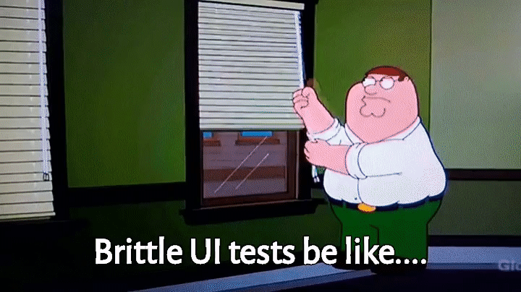

Slide 3
UI tests prove stuff works where it matters: in the browser

Slide 4


Slide 5
Today's agenda
When to use a UI test – and when not to
How we use the PageObject pattern
Tips for creating/managing test data
How to design UI-testable components

Slide 6
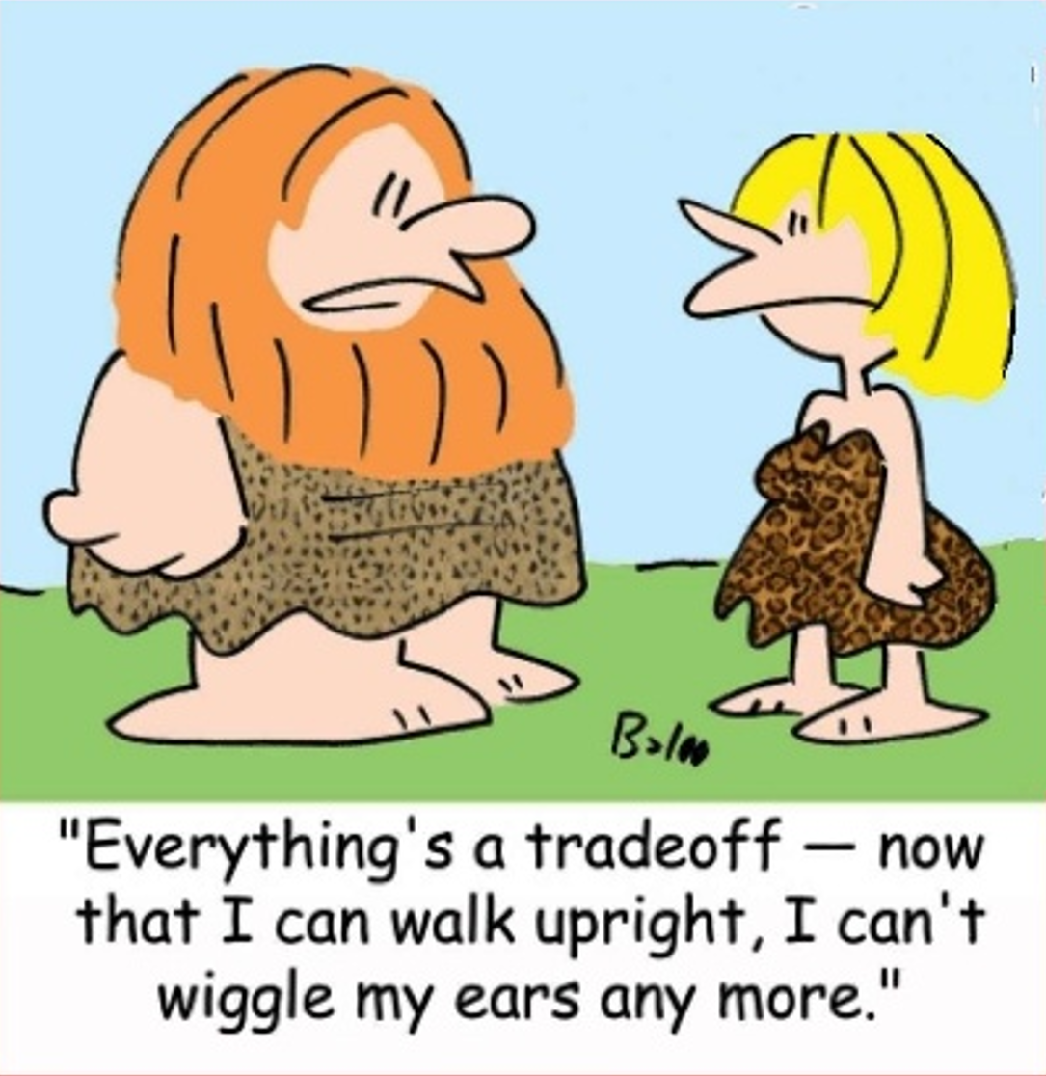

Slide 7
When should we use UI tests?
Only when lower-cost tests won't work instead

Slide 8
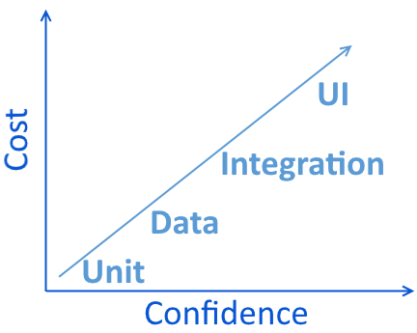
Types of Tests
UI / Functional
Integration
Data
Unit

Slide 9
Types of Tests
Use unit tests for…
Validating computations
Testing interactions between components (using mocks)
TDD
UI / Functional
Integration
Data
Unit

Slide 10

Types of Tests
UI / Functional
Integration
Data
Unit

Slide 11
Types of Tests
UI / Functional
Integration
Data
Unit

Slide 12
Types of Tests
Use data tests for…
UI / Functional
Integration
Data
Unit
Validating computations performed in the database
Verifying that queries return/modify the correct data
TDD (of the data layer)

Slide 13
Types of Tests
MVC Controller
View Model
Service Class
Data Component
Integration test (no mocks)
Data test
UI / Functional
Integration
Data
Unit

Slide 14
Types of Tests
UI / Functional
Integration
Data
Unit

Slide 15
Types of Tests
Use integration tests for…
UI / Functional
Integration
Data
Unit
Validating business logic that doesn't involve the UI
API testing

Slide 16
Types of Tests
UI / Functional
Integration
Data
Unit

Slide 17
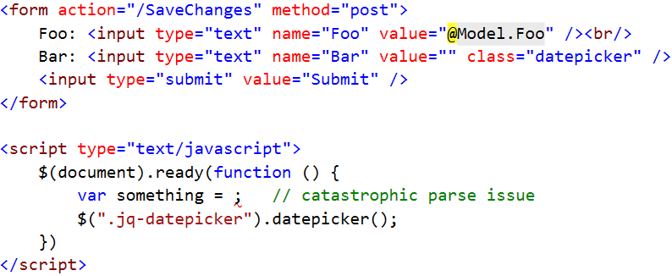
Types of Tests
UI / Functional
Integration
Data
Unit

Slide 18
Types of Tests
UI / Functional
Integration
Data
Unit

Slide 19
Types of Tests
UI / Functional
Integration
Data
Unit

Slide 20
Types of Tests
UI / Functional
Integration
Data
Unit

Slide 21
Types of Tests
UI / Functional
Integration
Data
Unit

Slide 22
Types of Tests
UI / Functional
Integration
Data
Unit

Slide 23
Types of Tests
Use UI tests for…
UI / Functional
Integration
Data
Unit
Validating that all UI elements work together
Testing user interaction rather than business rules

Slide 24
Types of Tests
UI
Integration
Data
Unit
UI / Functional
Integration
Data
Unit

Slide 25
Types of Tests
Unit
Data
UI / Functional
Integration
Data
Unit
UI
Integration

Slide 26
Setting up a UI test
Initial State
Initial Navigation
Assert()
Who's Logged In?

Slide 27
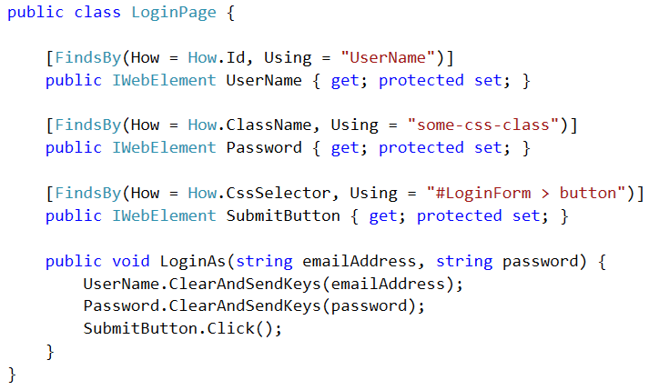
PageObject

Slide 28
PageObject

Slide 29
PageObject

Slide 30
PageObject

Slide 31
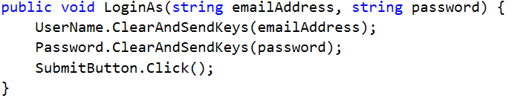
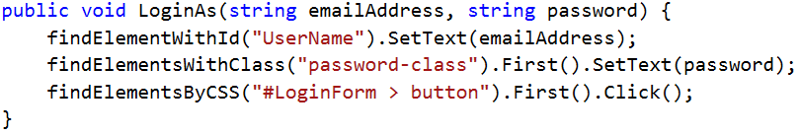
PageObject

Slide 32
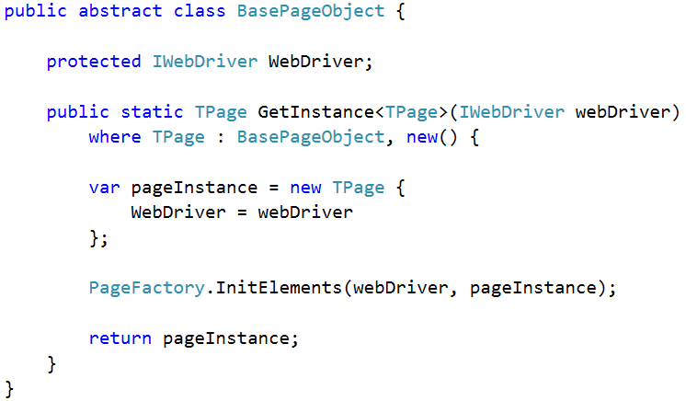
PageObject

Slide 33
PageObject

Slide 34
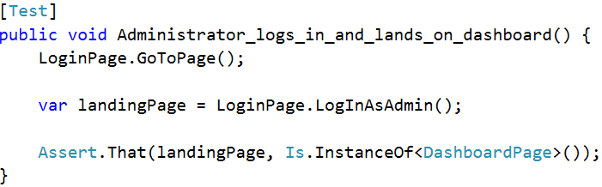
PageObject

Slide 35
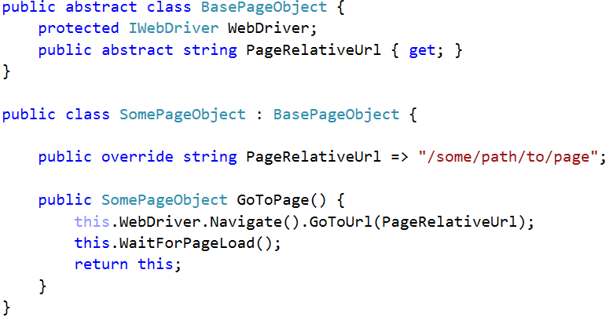
PageObject

Slide 36
PageObject
Notes:
Todo: "why not in base"?

Slide 37
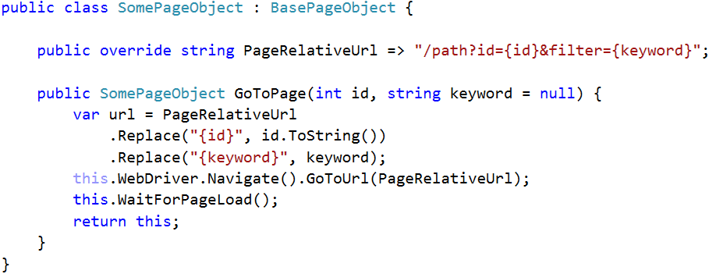
PageObject
Notes:
TODO: add click to show note "Every test begins with a GoTo!"

Slide 38
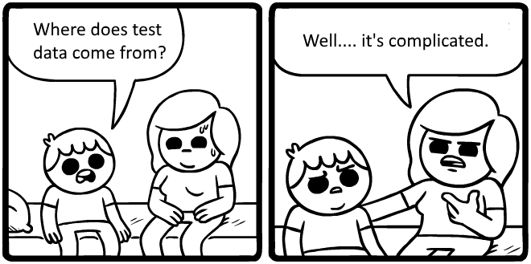

Slide 39
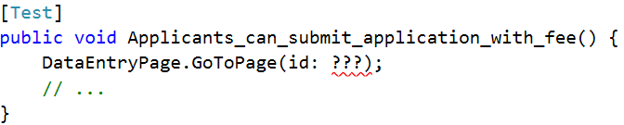
Pre-existing test data
Notes:
TODO: scribble "what goes here?"

Slide 40
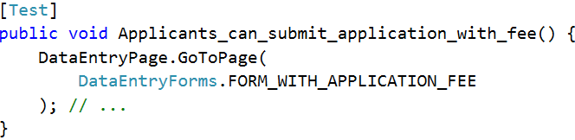
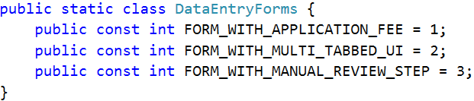
Pre-existing test data

Slide 41
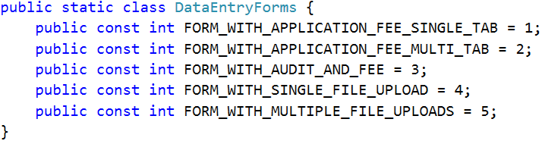
Pre-existing test data

Slide 42
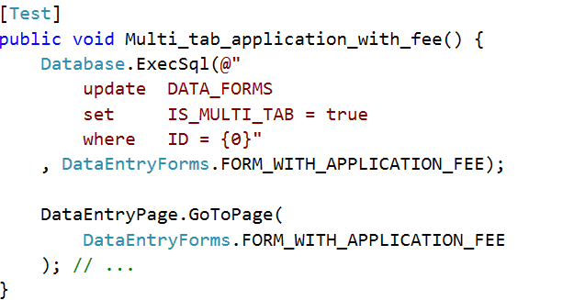
Pre-existing test data

Slide 43
Pre-existing test data

Slide 44
4 rules for using pre-existing test data
Only for UI tests

Slide 45
4 rules for using pre-existing test data
Only for UI tests
Only for data that's difficult to create per-test

Slide 46
4 rules for using pre-existing test data
Only for UI tests
Only for data that's difficult to create per-test
Only rely on loosely-defined data

Slide 47
4 rules for using pre-existing test data
Only for UI tests
Only for data that's difficult to create per-test
Only rely on loosely-defined data
No destructive operations
Notes:
TODO: Add header

Slide 48
4 rules for using pre-existing test data
Only for UI tests
Only for data that's difficult to create per-test
Only rely on loosely-defined data
No destructive operations
Notes:
TODO: Add header

Slide 49
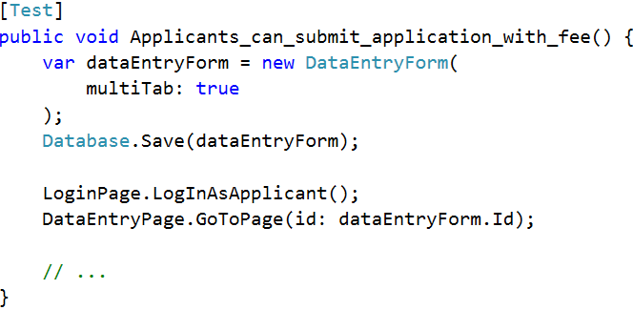
Creating test-specific data

Slide 50
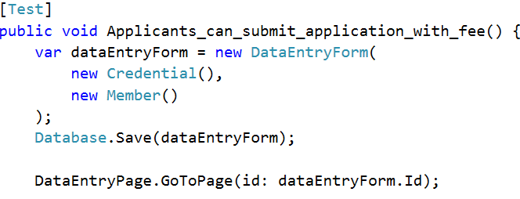
Creating test-specific data

Slide 51
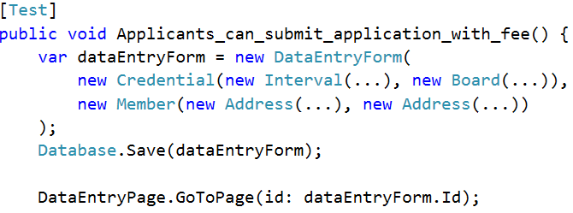
Creating test-specific data

Slide 52
Creating test-specific data

Slide 53
Creating test-specific data
Notes:
TODO: Pointer to "complexity"

Slide 54
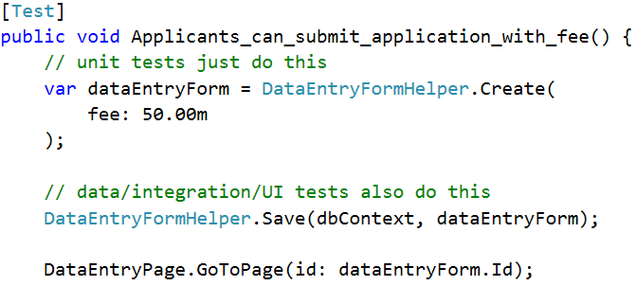
Creating test-specific data

Slide 55
Creating test-specific data

Slide 56
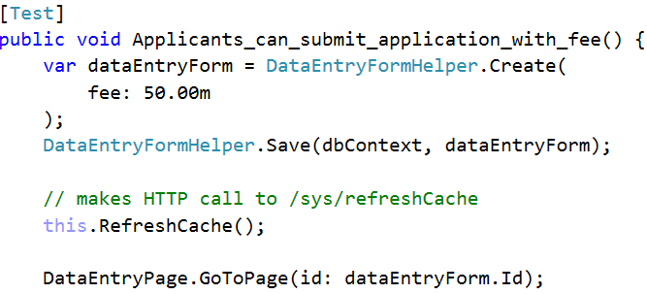
Creating test-specific data

Slide 57
Pre-existing
Tests easier to write / harder to maintain
Managing the database is a PITA
Created per-test
Tests harder to write / easier to maintain
Painful when tests need to change data
Each test run creates more data
Helpers & automation are a must!
Notes:
TODO: Call attention to "created per test"

Slide 58
Do not use side effects of one test as the starting point for another!

Slide 59
Test Data anti-pattern
Submit "New Widget" form
Load & Submit "Edit Widget" form
Submit "Delete Widget" form

Slide 60
Test Data anti-pattern
Submit "New Widget" form
Load & Submit "Edit Widget" form
Submit "Delete Widget" form
Use Widget in App

Slide 61


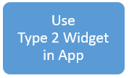
Test Data anti-pattern
Submit "New Widget" form
Load & Submit "Edit Widget" form
Submit "Delete Widget" form
Use Type 1 Widget in App

Slide 62
Test Data anti-pattern
Submit "New Widget" form
Load & Submit "Edit Widget" form
Submit "Delete Widget" form
Use Type 1 Widget in App
Notes:
TODO: issue 1

Slide 63
Test Data anti-pattern
Submit "New Widget" form
Load & Submit "Edit Widget" form
Submit "Delete Widget" form
Use Type 1 Widget in App
Notes:
TODO: issue 1

Slide 64
Test Data anti-pattern
Submit "New Widget" form
Load & Submit "Edit Widget" form
Submit "Delete Widget" form
Use Type 1 Widget in App
Notes:
TODO: issue 1

Slide 65
Writing UI-testable code Unit-testing a view model is better than UI-testing the DOM

Slide 66
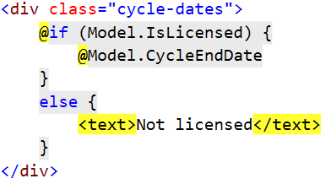
Refactor UI code to make it unit-testable

Slide 67
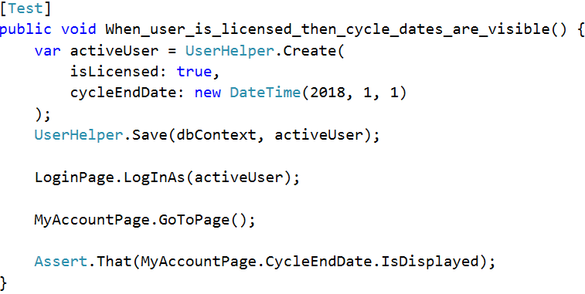
Refactor UI code to make it unit-testable

Slide 68
Refactor UI code to make it unit-testable
Notes:
TODO: Add "not"

Slide 69
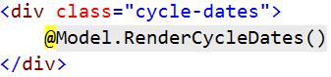
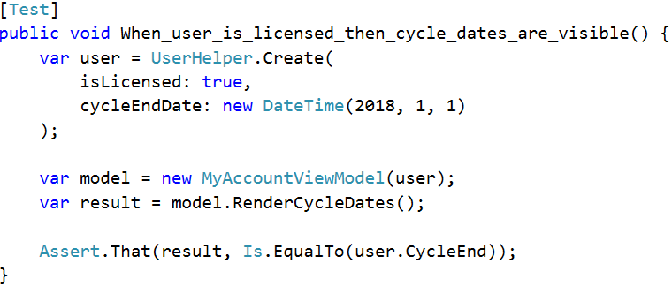
Refactor UI code to make it unit-testable

Slide 70
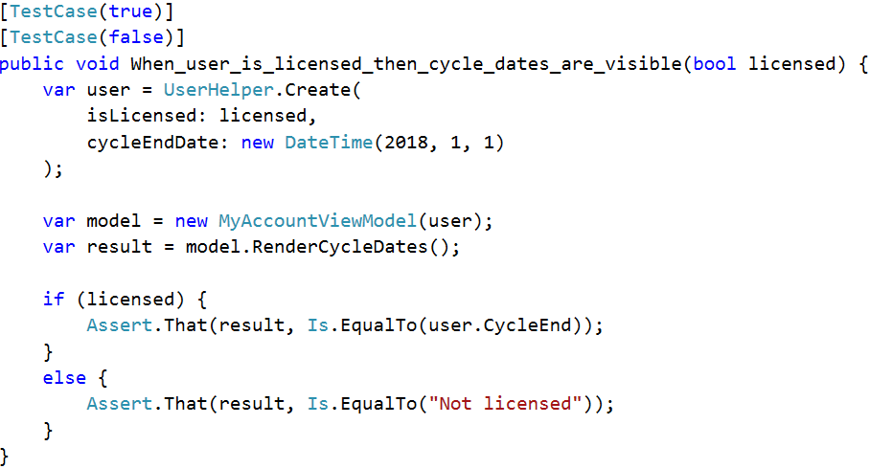
Refactor UI code to make it unit-testable
Notes:
Add note "don't do this…"

Slide 71
Writing UI-testable code Test-specific CSS classes and IDs are better than tight coupling to a rigid HTML structure

Slide 72
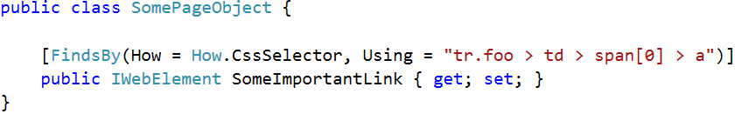
Use UI-test-specific CSS classes & IDs

Slide 73
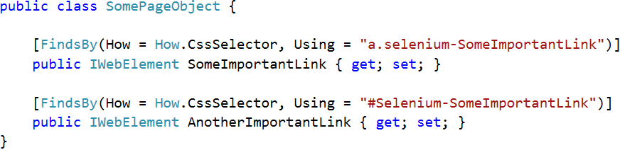
Use UI-test-specific CSS classes & IDs

Slide 74
Writing UI-testable code Test harnesses FTW

Slide 75
Components + Test Harnesses = WIN
Html.YourComponent(…)
$("#something").yourComponent({…})
Vue.component("yourComponent", {…})

Slide 76
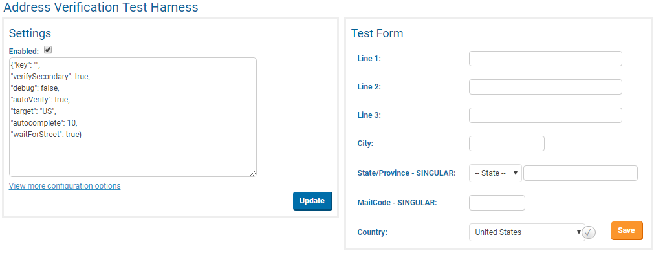
Components + Test Harnesses = WIN

Slide 77
Components + Test Harnesses = WIN
At least 1 test covers the in-app happy path
All other "if <condition> then <outcome>" tests use the harness

Slide 78
Takeaway #1 Have a deliberate test strategy; use UI tests to plug specific gaps left by lower-level tests

Slide 79
Takeaway #2 Dealing with test data sucks; use data creation helpers & automation make it better

Slide 80
Takeaway #3 Create test harnesses, then automate them

Slide 81
Happy Testing!
Have a deliberate test strategy – only UI test what you can't unit test instead.
Tests create their own data using helpers – use automation to clean up.
Test harnesses are awesome. Use them.
@spetryjohnson / seth@petry-johnson.com

